Slide 1



CAPSTONE PROJECT
Electric Vehicle Sales Analysis Dashboard
Presented By
Student Name: Aditya Rawat
College Name: VIT VELLORE
Department: BTECH. CSE
Email ID: aditya005rawat@gmail.com

Slide 2
OUTLINE:
Problem Statement (Should not include solution)
Proposed System/Solution
System Development Approach (Technology Used)
Algorithm & Deployment
Result (Output Image)
Conclusion
Future Scope
References

Slide 3
Problem Statement:
Electric Vehicles (EVs) are gaining significant importance as a sustainable alternative to conventional fuel vehicles. Governments and organizations are promoting EV adoption to reduce carbon emissions and support environmentally friendly transportation systems. However, with the rapid growth in EV adoption, large amounts of sales data are generated across different regions, vehicle categories, and time periods.
Analyzing this large dataset manually is difficult and time-consuming. Decision makers require an effective way to visualize and analyze EV sales trends to understand patterns such as which states have higher EV adoption, how sales change over time, and which vehicle categories are most popular.
Therefore, there is a need for a system that can transform raw EV sales data into meaningful insights through interactive visualizations and analytical dashboards.

Slide 4
Proposed Solution:
The proposed system is an interactive data analytics dashboard developed using Power BI to analyze Electric Vehicle sales data. The system focuses on converting raw EV sales data into meaningful visual insights that help users easily understand sales patterns and trends.
The solution involves the following steps:
Data Collection The dataset contains EV sales information including attributes such as year, month, state, vehicle class, vehicle category, and EV sales quantity.
Data Preprocessing The dataset is cleaned and prepared using Power BI's data transformation features. Unnecessary columns are removed and data is formatted correctly to ensure accurate analysis.
Data Visualization Different visual elements such as line charts, bar charts, pie charts, and treemaps are used to represent EV sales trends, regional adoption, and category distribution.
Interactive Analysis Slicers and filters are implemented to allow users to dynamically explore the data based on different parameters such as year, state, and vehicle category.
This system enables users to quickly identify patterns and make informed decisions based on EV sales data.

Slide 5
System Approach:
The system is developed using modern data visualization and analytics tools.
Hardware Requirements
Laptop or Desktop Computer
Minimum 8 GB RAM for smooth Power BI operation
Software Requirements
Microsoft Power BI for dashboard creation
Microsoft Excel for dataset storage and initial data viewing
Tools and Techniques Used
Power Query is used for data cleaning and transformation. Data Analysis Expressions (DAX) are used to create calculated measures such as total EV sales and distinct counts of states or vehicle categories. Interactive visualizations are created to represent EV sales trends in a clear and meaningful way.
The system integrates these technologies to build a user-friendly and efficient analytics dashboard.

Slide 6
Algorithm & Deployment:
Algorithm Selection
This project does not use machine learning algorithms but instead focuses on data analytics and visualization techniques. Power BI is used to analyze historical EV sales data and generate insights.
Data Input
Input data includes:
Year
Month
State
Vehicle Class
Vehicle Category
EV Sales Quantity
Processing
The data is processed using Power BI features such as:
Data cleaning using Power Query
Creation of calculated measures using DAX
Aggregation of EV sales by state, category, and time
Deployment
The dashboard is developed and deployed using Power BI Desktop where users can interact with charts and filters to explore EV sales trends.

Slide 7
Result:
The developed dashboard successfully converts raw EV sales data into meaningful visual insights. Various charts and visual elements help users understand the patterns in EV adoption across different regions and time periods.
Key outcomes of the project include:
Identification of top states with the highest EV adoption
Visualization of EV sales growth trends over multiple years
Analysis of vehicle category distribution within EV sales
Interactive filtering of data based on year, state, vehicle class, and category
The dashboard provides a clear and interactive platform for exploring EV sales data and understanding the factors influencing EV adoption.

Slide 8
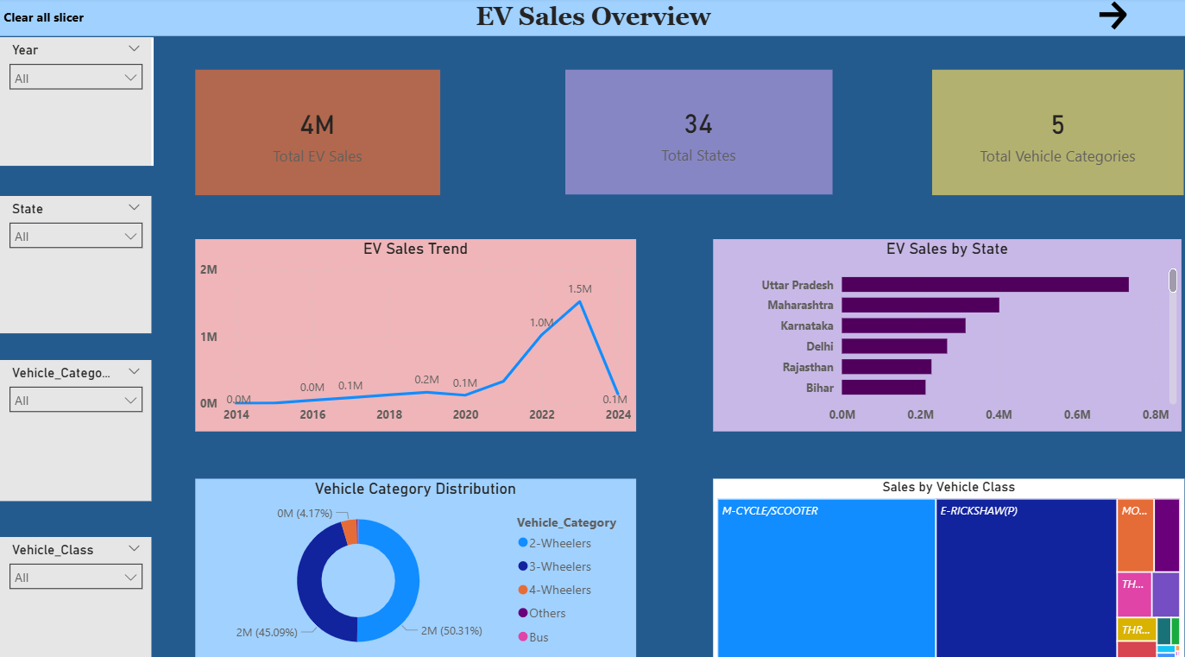
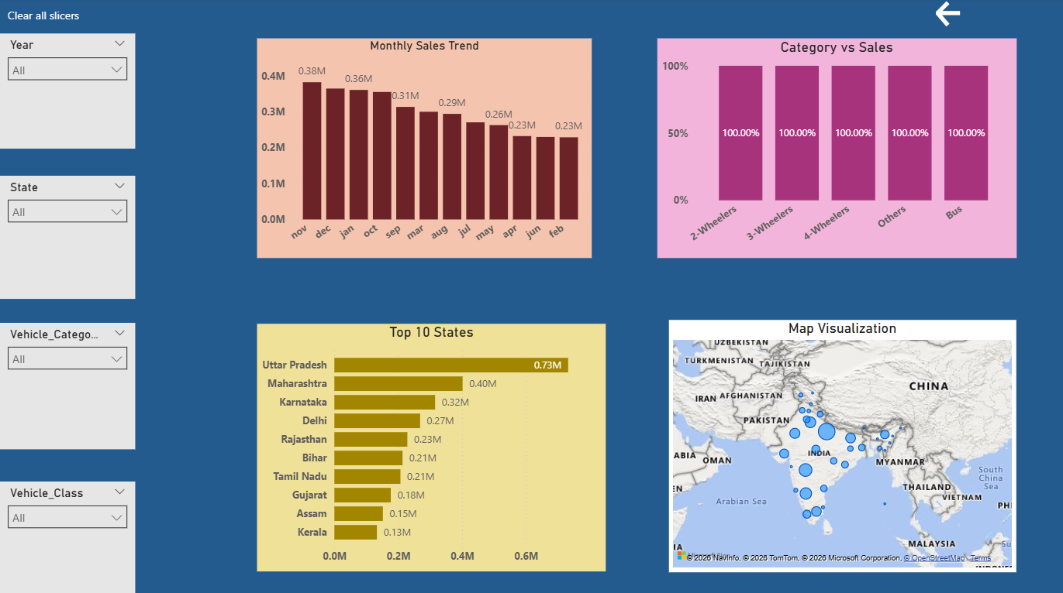
OUTPUT(SCREENSHOTS):

Slide 9
OUTPUT(SCREENSHOTS):

Slide 10
Conclusion:
The Electric Vehicle Sales Analysis Dashboard demonstrates how data visualization tools can transform raw datasets into meaningful insights. By using Power BI, EV sales data can be analyzed efficiently and presented through interactive visualizations that are easy to interpret.
The dashboard helps users identify trends in EV adoption across different states, time periods, and vehicle categories. This makes it easier for stakeholders to understand market behavior and support decision-making processes related to electric mobility and sustainable transportation.

Slide 11
Future scope:
The project can be extended in several ways to enhance its capabilities.
Real-time EV sales data can be integrated to provide live monitoring of EV adoption trends. Advanced analytics techniques such as predictive modeling can be implemented to forecast future EV sales. Additional datasets such as charging infrastructure, government incentives, and environmental impact data can be included to provide deeper insights.
The dashboard can also be deployed on Power BI Service to enable online access and sharing with a larger audience.

Slide 12
References:
EV Sales Dataset Source
Microsoft Power BI Documentation
Microsoft Learn Power BI Tutorials
Data Visualization and Analytics Resources
GitHub : https://github.com/adityarawat-05/EV-Sales-PowerBi-Dashboard

Slide 13
Thank You

